Slide 1
Threaded Binary Trees
According to this idea we are going to replace all the null pointers by the appropriate pointer values called threads.

Slide 2
Some Properties of BT
The maximum number of nodes with height h of a binary tree is 2^{h+1}-1.
For any nonempty binary tree, T,
if n0 is the number of leaf nodes and
n2 the number of nodes of degree 2,
then n0=n2+1

Slide 3
Inorder Traversal (recursive version)
void inorder(tree_pointer ptr)
/* inorder tree traversal */
{
if (ptr) {
inorder(ptr->left_child);
printf(“%d”, ptr->data);
inorder(ptr->right_child);
}
}
A / B * C * D + E

Slide 4
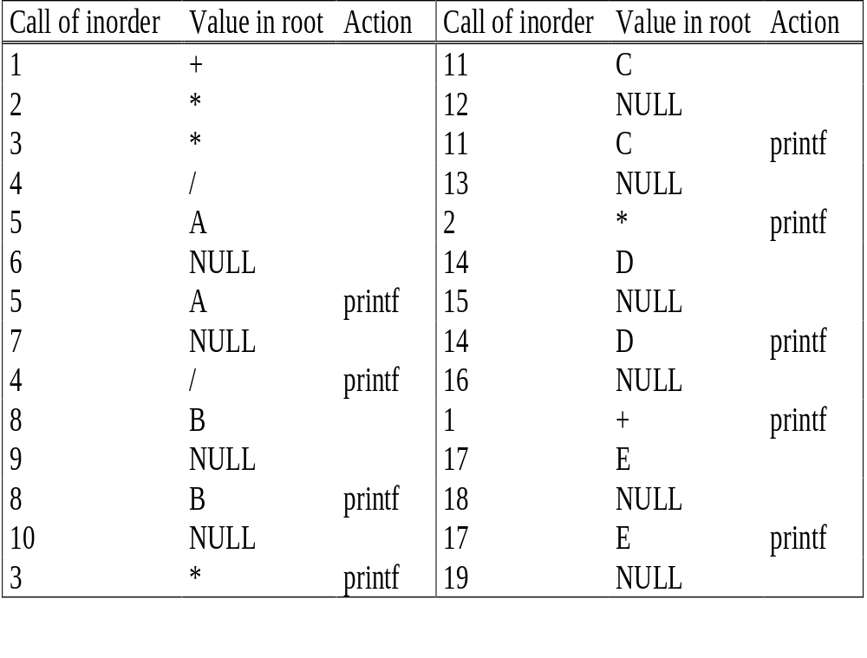
Trace Operations of Inorder Traversal
+
*
E
*
D
/
C
A / B * C * D + E
A
B

Slide 5
Threaded Trees
Binary trees have a lot of wasted space: the leaf nodes each have 2 null pointers
We can use these pointers to help us in inorder traversals
We have the pointers reference the next node in an inorder traversal; called threads
We need to know if a pointer is an actual link or a thread, so we keep a boolean for each pointer

Slide 6
Threaded Binary Trees
Two many null pointers in current representation
of binary trees (skewed tree)
n: number of nodes
number of non-null links: n-1
total links: 2n
null links: 2n-(n-1)=n+1
Replace these null pointers with some useful “threads”.

Slide 7
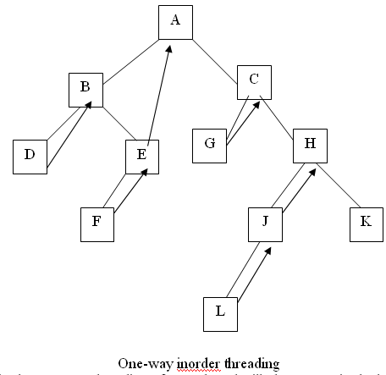
Threaded Binary Tree
Also one may choose a one-way threading or a two-way threading.
Threaded Binary Tree One-Way
in the one way threading of T,
a thread will appear in the right field of a node and will point to the next node in the in-order traversal of T.
Inorder of below tree is: D,B,F,E,A,G,C,L,J,H,K

Slide 8
Threaded Binary Tree Two-Way
If ptr->left_child is null,
replace it with a pointer to the node that would be
visited before ptr in an inorder traversal
(inorder predeccessor)
If ptr->right_child is null,
replace it with a pointer to the node that would be
visited after ptr in an inorder traversal
(inorder successor)

Slide 9
Threaded Binary Tree Two-Way…..continued
root
A
dangling
B
C
dangling
D
E
F
G
H
I
inorder traversal:
H, D, I, B, E, A, F, C, G

Slide 10
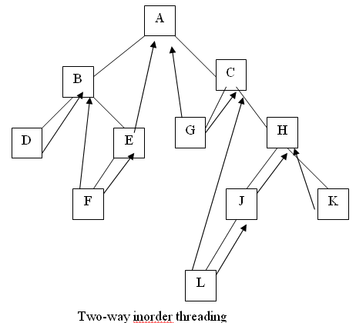
Threaded Binary Tree Two-Way…..continued
In two-way threading of T.
A thread will also appear in the left field of a node and will point to the preceding node in the in-order traversal of tree T.
Furthermore, the left pointer of the first node and the right pointer of the last node (in the in-order traversal of T) will contain the null value when T does not have a header node.

Slide 11
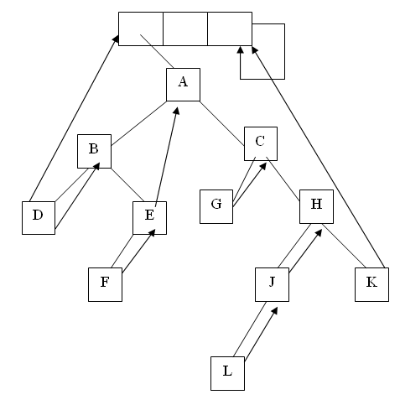
Threaded Binary Tree Two-Way

Slide 12
Node Structure for Threaded BT
left_thread left_child data right_child right_thread
TRUE
●
●
FALSE
TRUE: thread
FALSE: child
class Node {
int data;
Node * left_child, * right_child;
boolean leftThread, rightThread;
}

Slide 13
Memory Representation of a Threaded BT
root
A
dangling
B
C
dangling
D
E
F
G
H
I
root
--
f
f
f
A
f
f
B
f
f
C
f
f
D
f
t
E
t
t
F
t
t
G
t
t
H
t
t
I
t

Slide 14
Inorder Traversal of Threaded BT
void tinorder(threaded_pointer tree)
{
/* traverse the threaded binary tree inorder */
threaded_pointer temp = tree;
for (;;) {
temp = insucc(temp);
if (temp==tree) break;
printf(“%d”, temp->data);
}
}
O(n)

Slide 15
Next Node in Threaded BT
threaded_pointer insucc(threaded_pointer tree)
{
threaded_pointer temp;
temp = tree->right_child;
if (!tree->right_thread)
while (!temp->left_thread)
temp = temp->left_child;
return temp;
}

Slide 16
Insertion
It’s a little more complicated to insert a new node into a threaded BST than into an unthreaded one.
We must set the new node's left and right threads to point to its predecessor and successor, respectively
Suppose that new node n is the right child of its parent p. This means that p is n's predecessor, because n is the least node in p's right subtree.

Slide 17
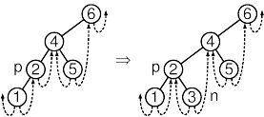
continued
n's successor is therefore the node that was p's successor before n was inserted, ie, it is the same as p's former right thread.

Slide 18
Inserting Node into
Threaded BTs
A
(1)
parent
B
(3)
C
D
child
(2)
Insert child as the right child of node parent
  change parent->right_thread to FALSE
  set child->right_child to
  parent->right_child
  set child->left_child to point to parent
  change parent->right_child to point to child
  set child->left_thread and
  child->right_thread to TRUE

Slide 19
Examples
Insert a node D as a right child of B.
root
root
A
A
(1)
parent
B
parent
B
(3)
child
child
C
D
C
D
empty
(2)

Slide 20
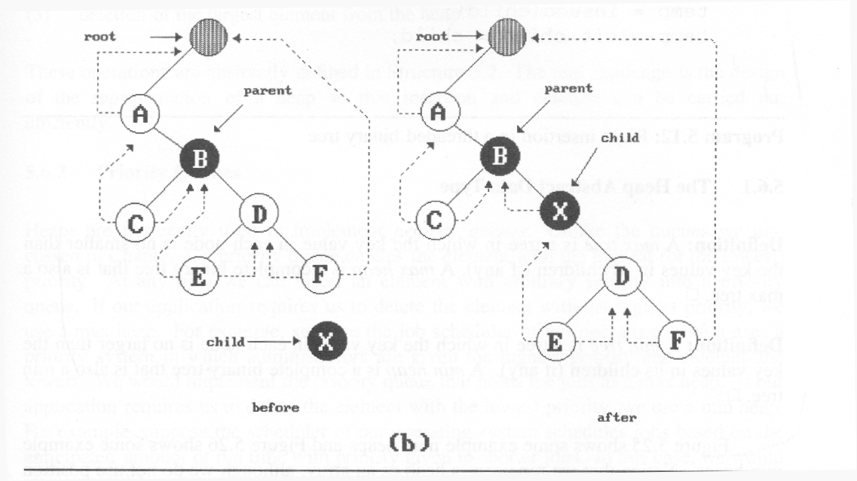
(3)
(2)
(1)
(4)
nonempty
Insertion of child as a right child of parent in a threaded binary tree

Slide 21
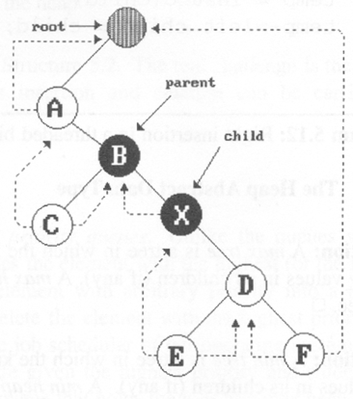
Right Insertion in Threaded BTs
void insert_right(threaded_pointer parent,
threaded_pointer child)
{
threaded_pointer temp;
child->right_child = parent->right_child;
child->right_thread = parent->right_thread;
child->left_child = parent; case (a)
child->left_thread = TRUE;
parent->right_child = child;
parent->right_thread = FALSE;
if (!child->right_thread) { case (b)
temp = insucc(child);
temp->left_child = child;
}
}
(1)
(2)
(3)
(4)

Slide 22
Advantages of threaded binary tree:
Threaded binary trees have numerous advantages over non-threaded binary trees listed as below:
The traversal operation is more faster than that of its unthreaded version, because with threaded binary tree non-recursive implementation is possible which can run faster and does not require the botheration of stack management.
The second advantage is more understated with a threaded binary tree, we can efficiently determine the predecessor and successor nodes starting from any node. In case of unthreaded binary tree, however, this task is more time consuming and difficult. For this case a stack is required to provide upward pointing information in the tree whereas in a threaded binary tree, without having to include the overhead of using a stack mechanism the same can be carried out with the threads.

Slide 23
Advantages of threaded binary tree:
  Any node can be accessible from any other node. Threads are usually move to upward whereas links are downward. Thus in a threaded tree, one can move in their direction and nodes are in fact circularly linked. This is not possible in unthreaded counter part because there we can move only in downward direction starting from root.
  Insertion into and deletions from a threaded tree are although time consuming operations but these are very easy to implement.

Slide 24
Disadvantages of threaded binary tree:
  Insertion and deletion from a threaded tree are very time consuming operation compare to non-threaded binary tree.
  This tree require additional bit to identify the threaded link.

